Slide 1
AI DENOISER

Slide 2
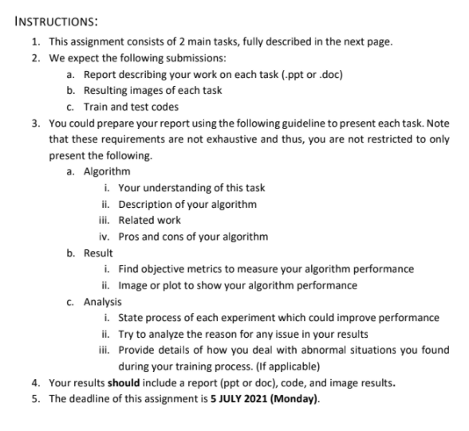
U-net model
( encoder -> decoder with concat layers)
Optimiser ⇒ adam (0.002)

Slide 3
MSE in model building,
PSNR in model evaluation

Slide 4
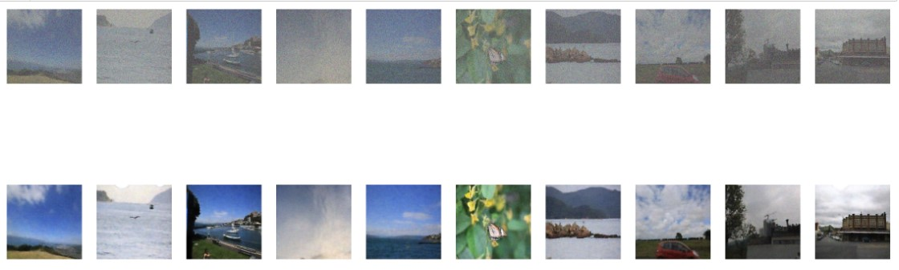
Task 1 RESULTS
gaussian noise filter 0.9
Predicted image

Slide 5
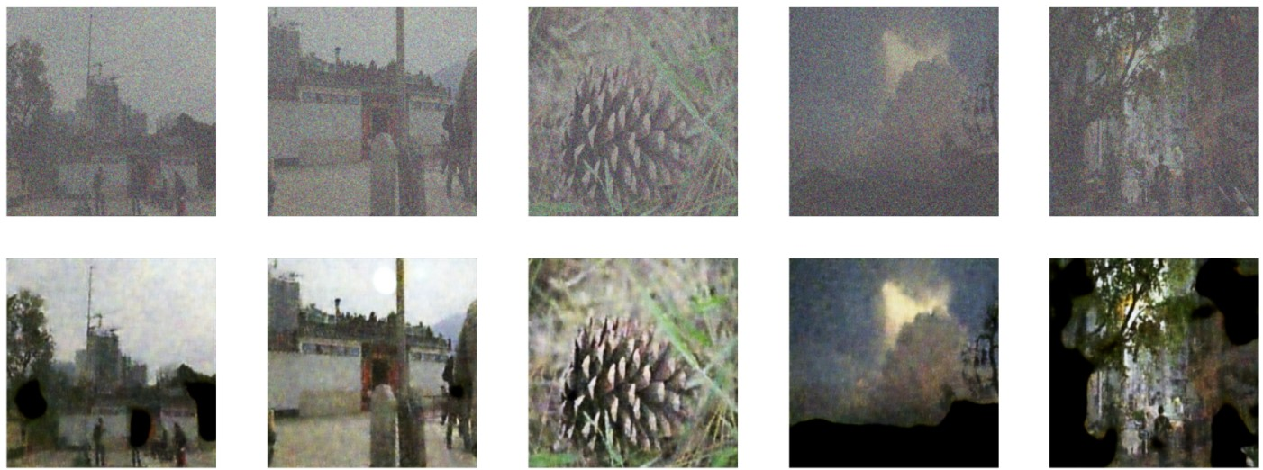
TASk 2 RESULTS
Jpg compression 0.6 + gaussian noise filter 0.9
Predicted image

Slide 6
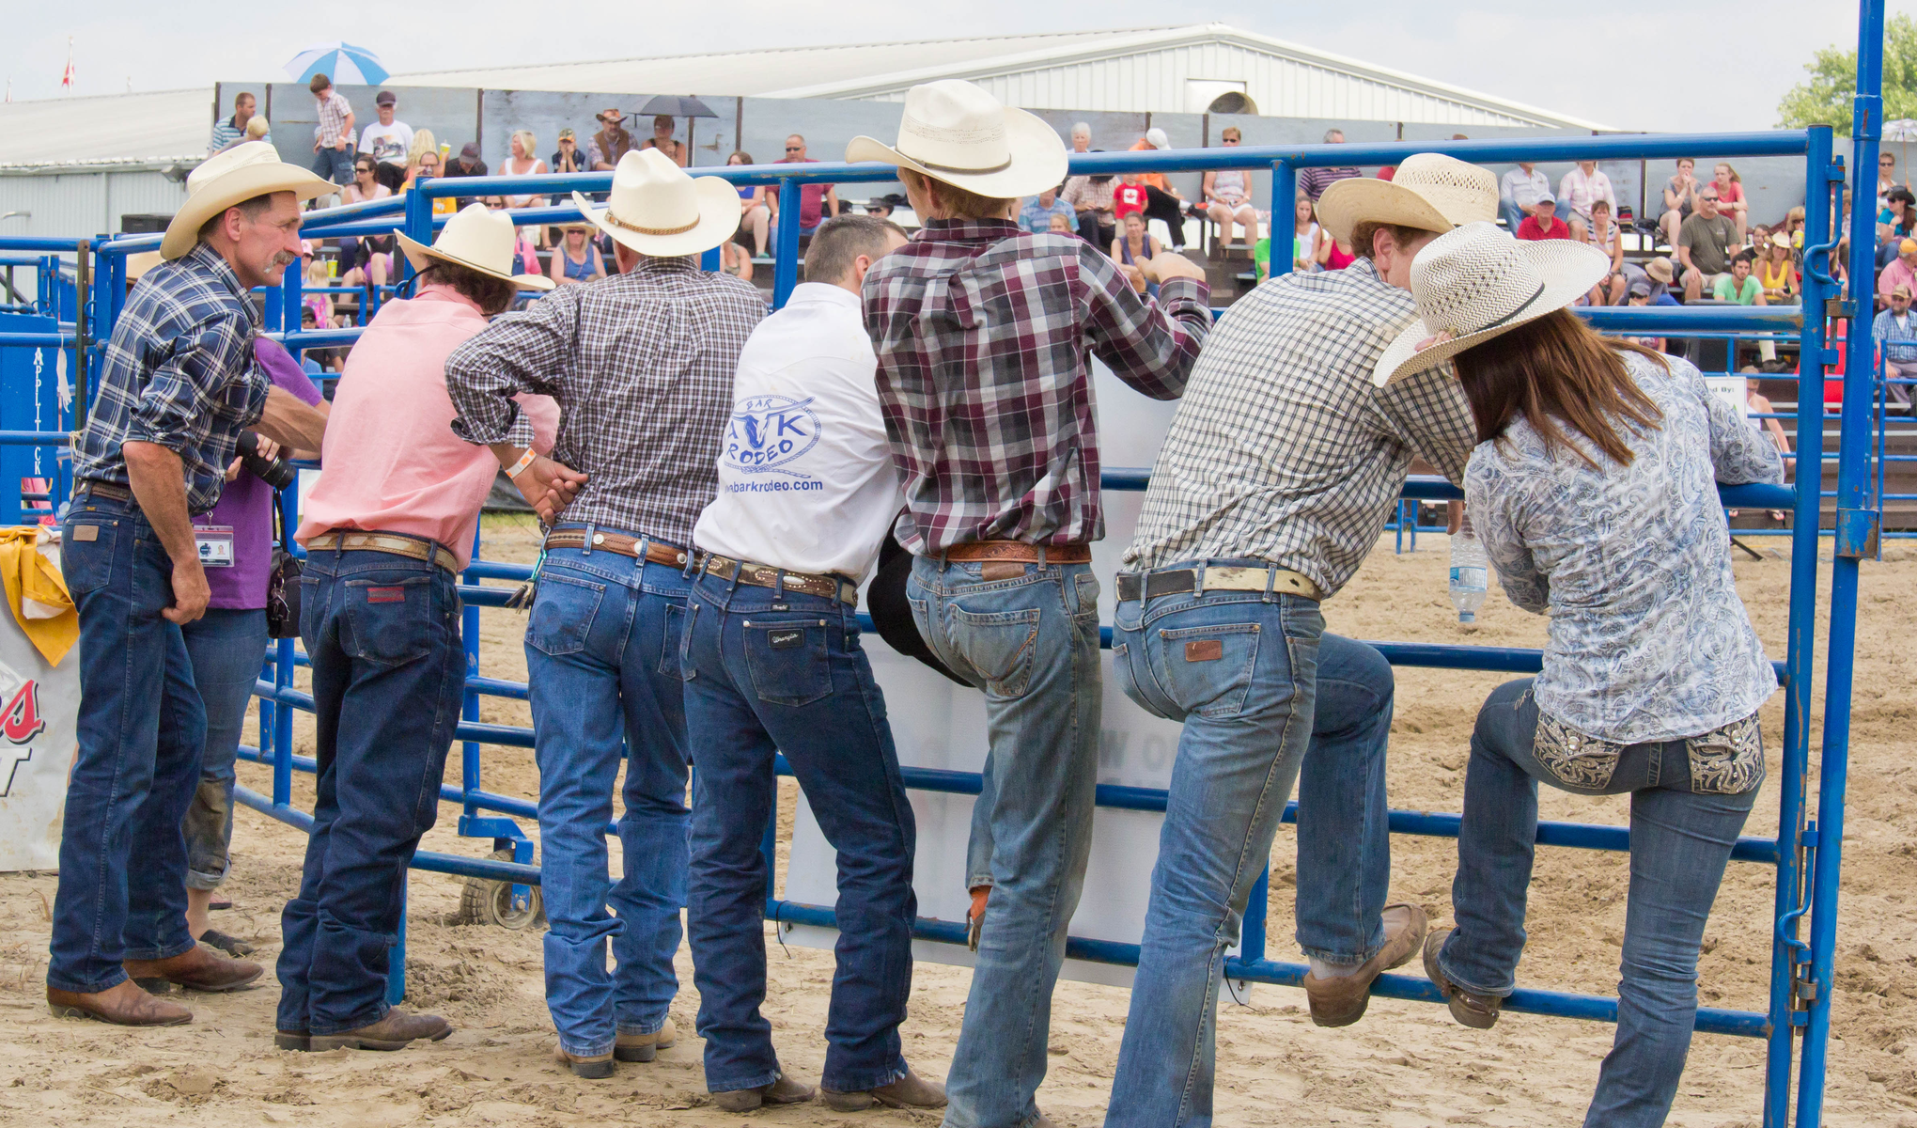
Method 1
resize
Orig_height
= 1200
input_size
= 1024x1024
Cv2.resize, inter_cubic
orig_width = 2040
auto encoder
max_epochs = 150
batch_size = 16
mask_height
= 1200
input_size
= 1024x1024
Cv2.resize, inter_cubic
mask_width = 2040

Slide 7
Method 1
resize
Orig_height
= 1200
input_size
= 256x256
Cv2.resize, inter_cubic
orig_width = 2040
auto encoder
max_epochs = 150
batch_size = 16
mask_height
= 1200
output_size
= 256x256
Cv2.resize, inter_cubic
mask_width = 2040

Slide 8
Method 2
Image split predict
Orig_height
= 1200
input_size
= 256x256
Split into tiles of size 256x256x3 ⇒ predict all tiles
orig_width = 2040
auto encoder
max_epochs = 150
batch_size = 16
Combine all tiles
mask_height
= 1200
output_size
= 256x256
mask_width = 2040

Slide 9
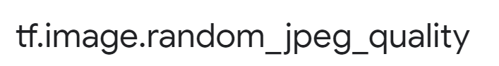
Use personal Dataset *I use my own family holiday pictures since they were in my computer
1753 images ⇒ * not clean properly ( did not have sufficient time to look at individual images)
Train = 1228 | 0.7%
Test = 525 | 0.3%
Data Prep Stage
Original image size ⇒ 3840x5760x3 H,W,C
Resize ⇒ 256x256x3
Task 1
Gaussian filter applied =>
** I applied the same noise filter
( ** by accident instead of applying a random.range on the gaussian filter )
Task 2
*this is the same for the jpeg compression + noise filter
All images were compressed by the same amount
( ** by accident I should have used a random.range when applying jpeg compression )
** Mistake was not corrected as the amount of time to upload the data into g drive was (super long) (my current work requires me to use vpn hence connection is bad) and it's been a busy week at work

Slide 10
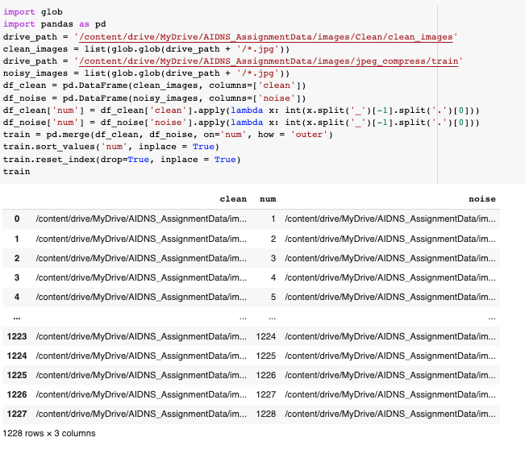
Build dataframe for path to image

Slide 11
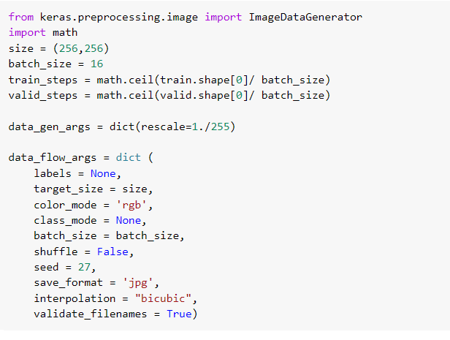
Did not apply transformations as i want to ensure that images pass in are received in the exact same outputs
(only rescale 1/255.0)
Noisy
clean
Flow from dataframe
Flow from dataframe
Zip 2 generators into 1 generator

Slide 12
CNN Autoencoder ( 1st approach) Tried and failed
Encoder
256,256,3 input layer
128, 128, 32 Conv2d
64,64,32 maxpooling2d
32,32,64 Conv2d
16,16,128 maxpooling2d
8,8,128 conv2d
4,4,128 maxpooling2d
2048 flatten
512 dense ( middle layer )
Input
Conv2D,
stride=2, padding = same
Conv2D
Conv2D
Maxpooling2D
Conv2D
Flatten

Slide 13
Decoder
512 dense ( middle layer )
4,4,128 reshape
8,8,128 Conv2dT
16,16,128 upsampling
32,32,64 Conv2dT
64,64,64 upsampling
128,128,32 Conv2d
256,256,32 maxpooling2d
256,256,3 conv2d
Dense
Reshape
Conv2DTranspose
Conv2DT,
stride=2, padding = same
Conv2DTranspose
Conv2DTranspose
Upsampling
Conv2D

Slide 14
CNN Autoencoder ( 2nd approach) U-net
Output
Encoder
Conv2D
Conv2D,
Input
Conv2D,
Conv2D, conv1
Conv2DTranspose
LeakyRelu
Conv2D, conv2
Conv2DTranspose
LeakyRelu
Conv2DTranspose
Conv2D, conv3
Dropout
Conv2DTranspose
Dropout
Conv2D, conv4
Conv2DTranspose
Conv2D, conv5
Batch Normalisation
Batch Normalisation
Conv2D, conv6

Slide 15
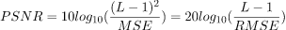
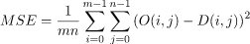
Evaluation
Peak signal-to-noise ratio (PSNR)
MSE is the mean squared error

